Slide 1
Mintendo Swich
組員:廖耕毅 門玉仁 陳妍喻

Slide 2
Outline
Project introduction
Project structure
Demo clip
Improvement
Low energy consideration(ISR, sleeping mode)
wifi session handling
Precise motion detection handling
Conclusion
Still existing problems

Slide 3
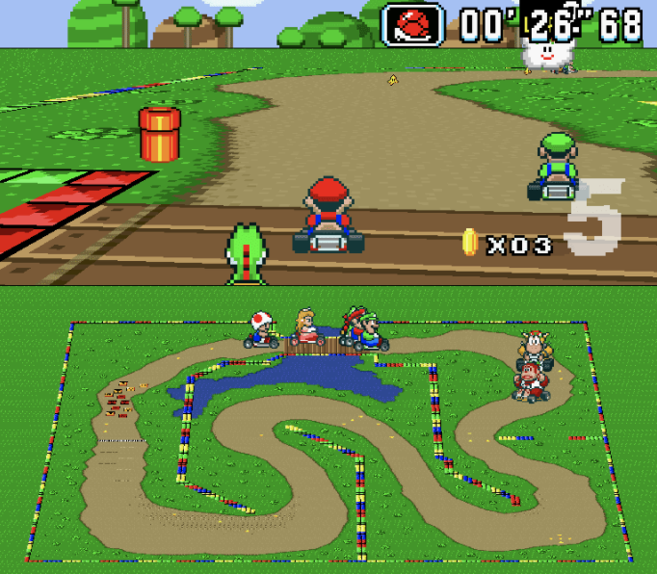

Project Introduction
We intended to design stm32 as a video game controller which can easily adapt on different video games with sensitive controlling, low energy consideration and some user friendly designs.
Specifically, we will demonstrate our project on Mario kart game and pong.

Slide 4
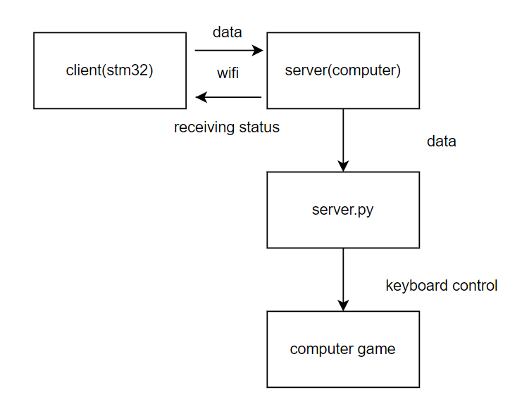
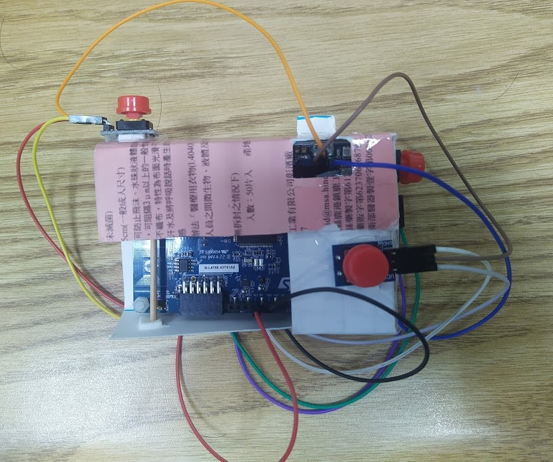
Project Structure and Controller Design

Slide 5
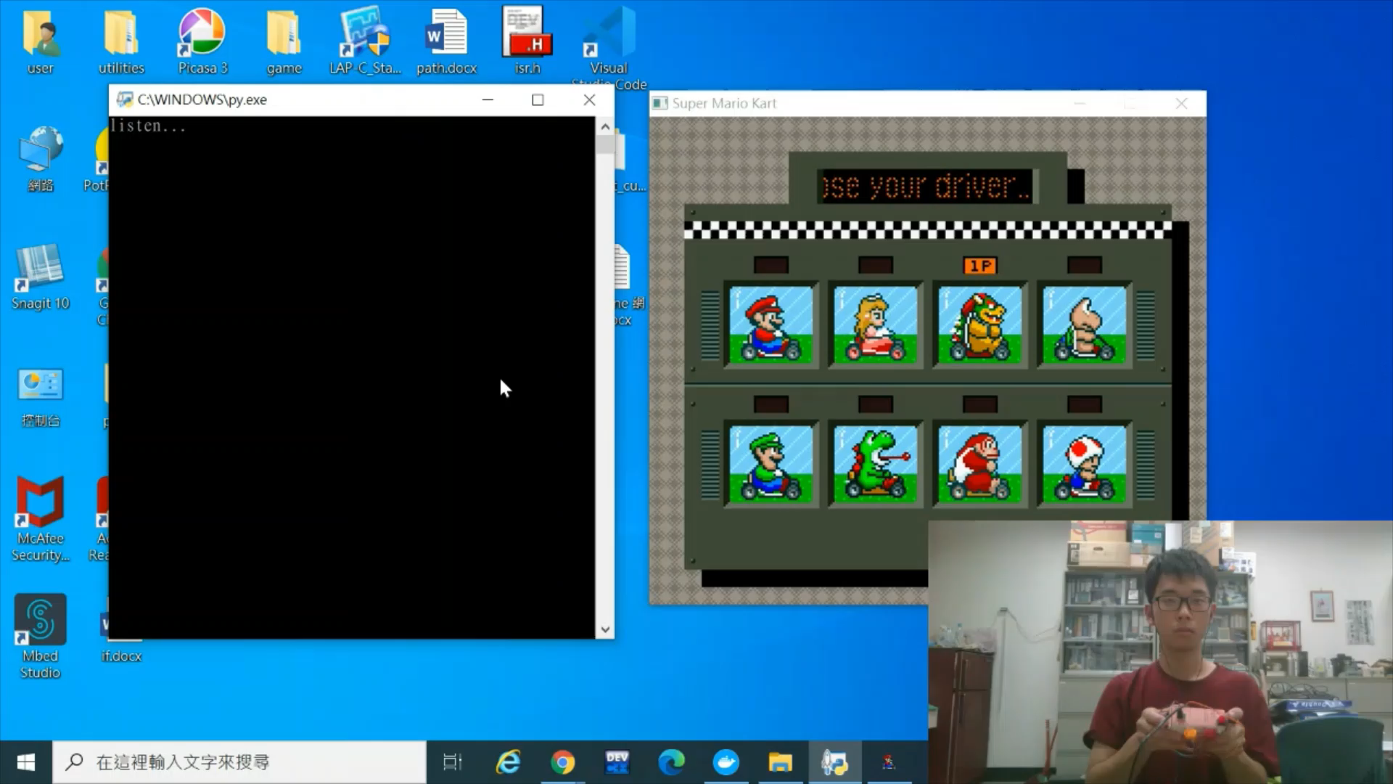
Demo Clips – Mario Kart

Slide 6
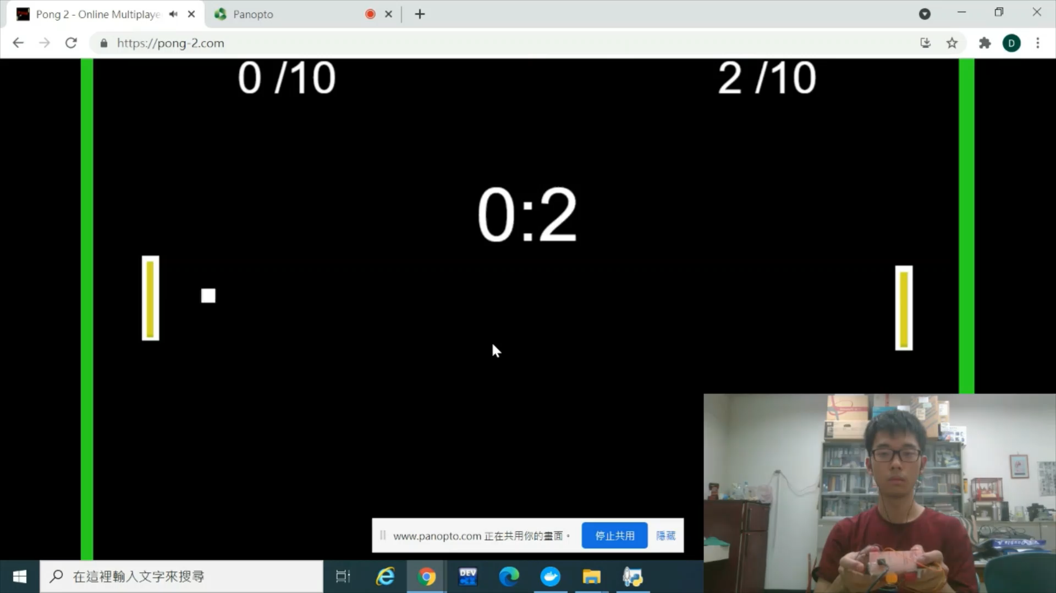
Demo Clips – Pong

Slide 7
Improvements-Low Energy Design(ISR)
Purpose: pressing button triggers ISR to send data to server
Problem 1:
Description: Bouncing -> trigger ISR multiple times with incorrect reading value
Solution: Disable IRQ -> program order is important
Problem 2:
Description: Multiple interruptins -> cause program malfunction
Maybe sharing same interrupt vector -> unsolved

Slide 8
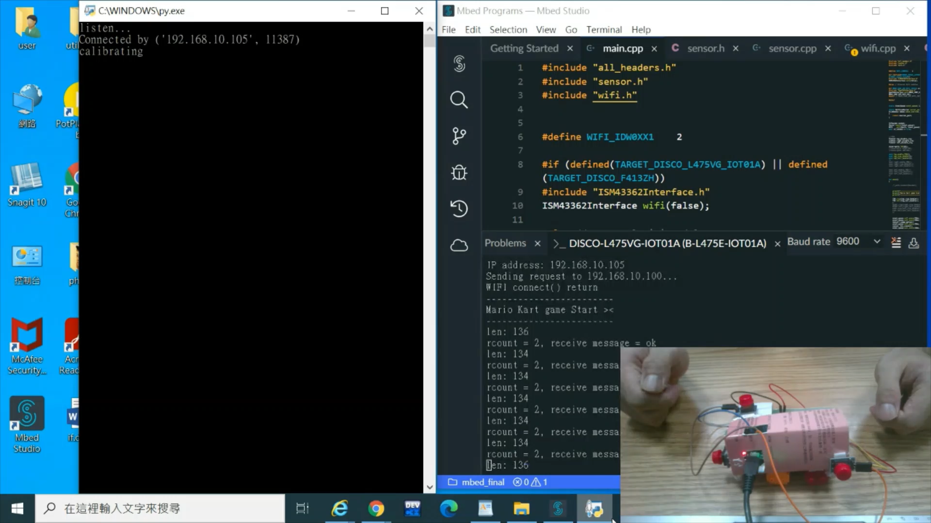
Improvements-Low Energy Design(Sleeping Mode)
Purpose: If no motion occurs, stm32 will enter sleeping mode(e.g. not sending data to server) to save energy.
With high sensitivity, we will not miss any motion

Slide 9
WIFI Session Handling

Slide 10
Precise Motion Detection Handling
Problem: After stm32 sensor’s calibration, bias still remains.
Description: Bias are random offsets, which hugely limits detection accuracy
Solution: Calibrate once more on server
Benefits: This greatly enhance our detection accuracy
Future work: during gaming your hand’s position will change slightly which will again affect detection accuracy -> dynamic calibration

Slide 11
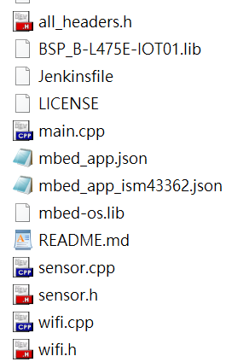
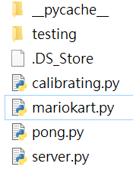
Conclusion - Project
Key board manipulation:
Easily adapt on different games
Avoid game looping asynchronous problem
Low energy consideration
ISR
Sleeping mode
Wifi reconnection design
Precise motion detection
Manageable OOP design
Server
client

Slide 12
Conclusion – Used Course Materials
Interrupt Service Routine
bouncing handling
Event and eventqueue
Sensor node
Wifi and client socket server

Slide 13
Still Existing Problems
Multiple Interruptins implementation
Dynamic calibration

Slide 14
Thanks For Your Attention

